Slide 1
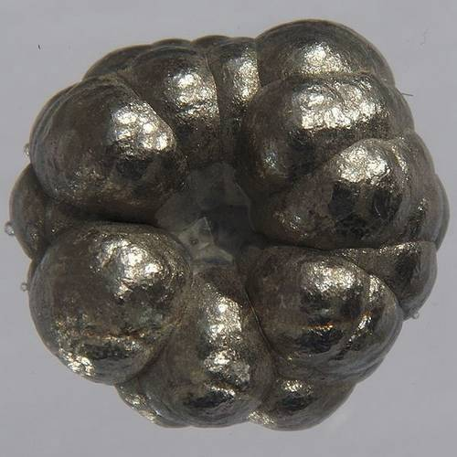
transition metals
Nickel

Slide 2
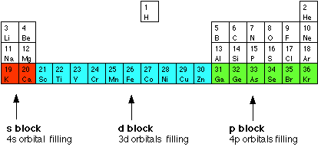
d block elements.

Slide 3
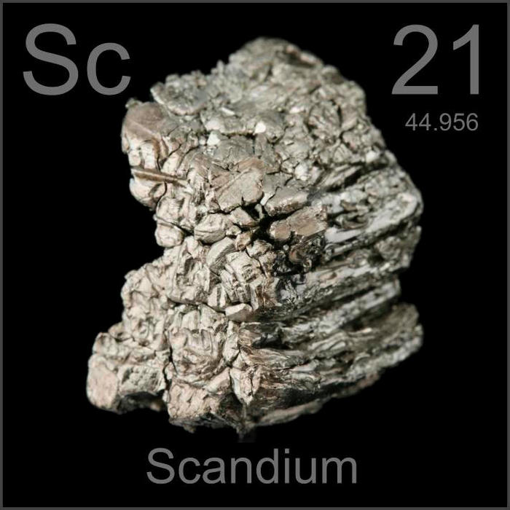
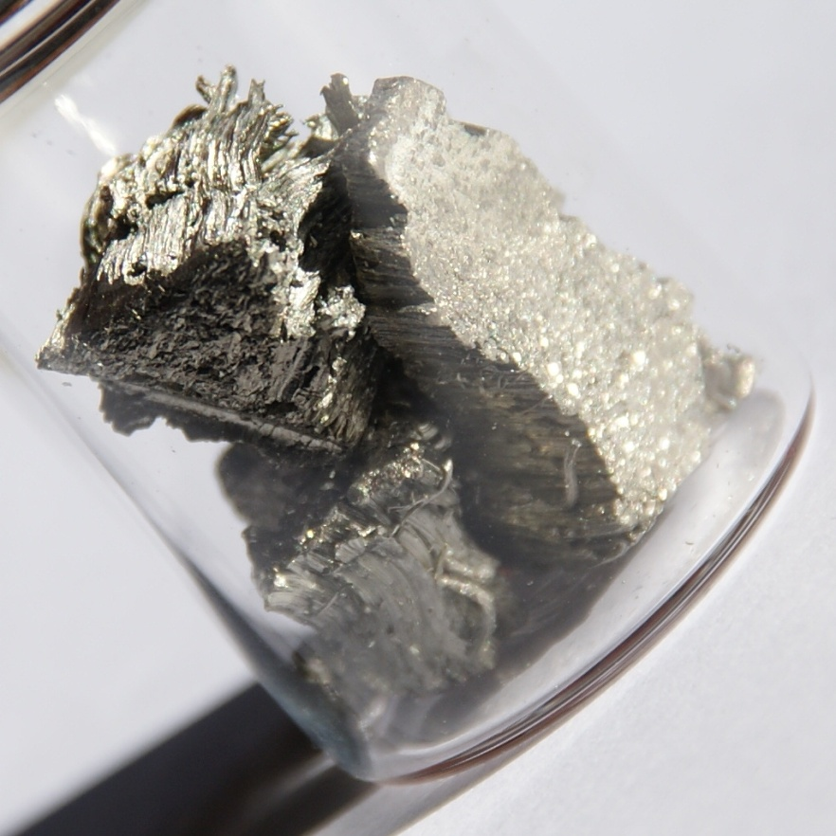
scandium

Slide 4
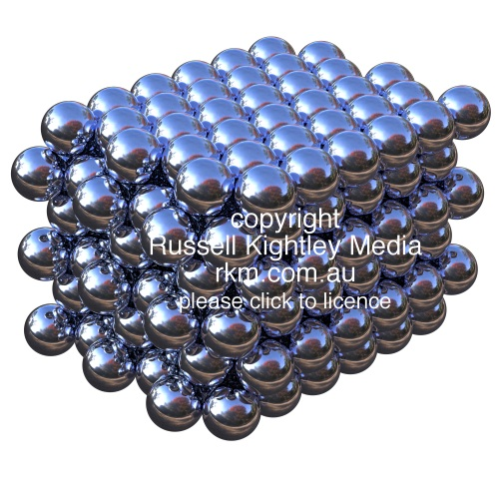
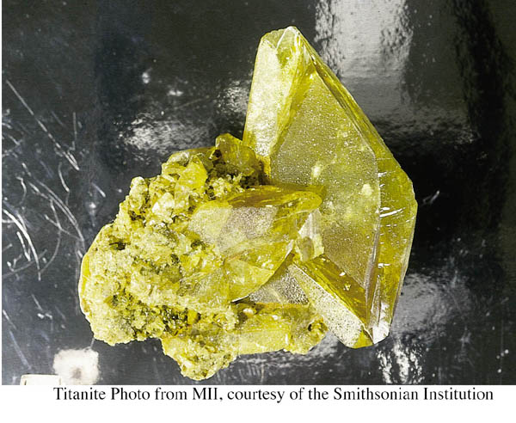
Titanium
Titanium atoms arranged in a face centred cubic pattern
the photo is a mineral collector’s specimen of titanite .

Slide 5
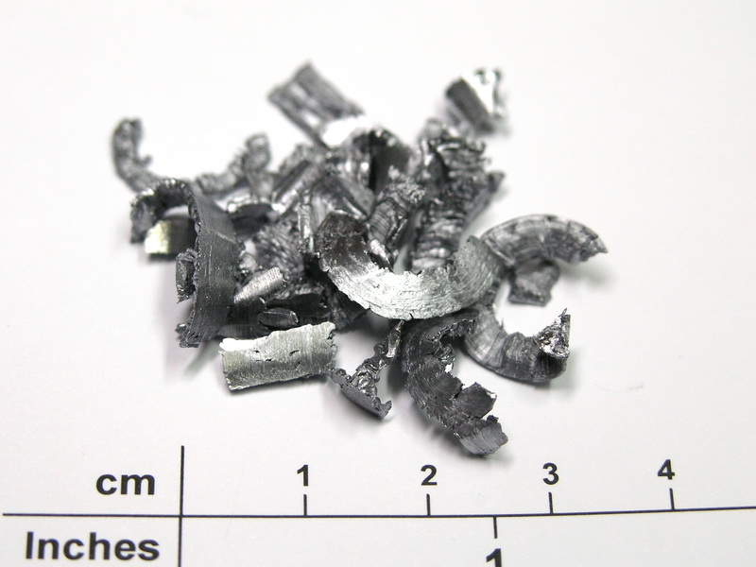
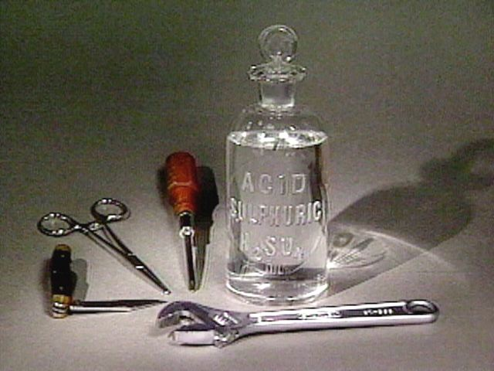
Vanadium
Vanadium metal
Uses: tools, stainless steels, catalyst in the production of H₂SO₄.

Slide 6
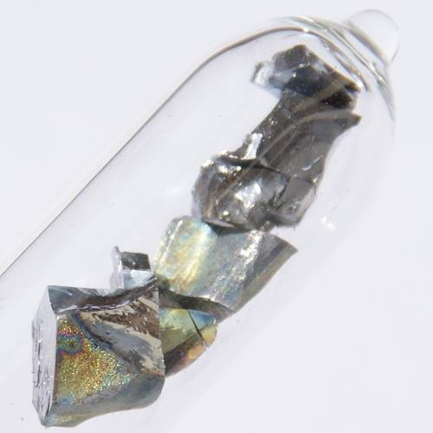
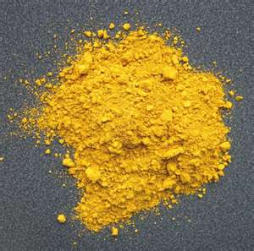
Vanadium (v) oxide
A pieces of pure vanadium, which show vanadium's characteristic rainbow-colored oxide layer.

Slide 7
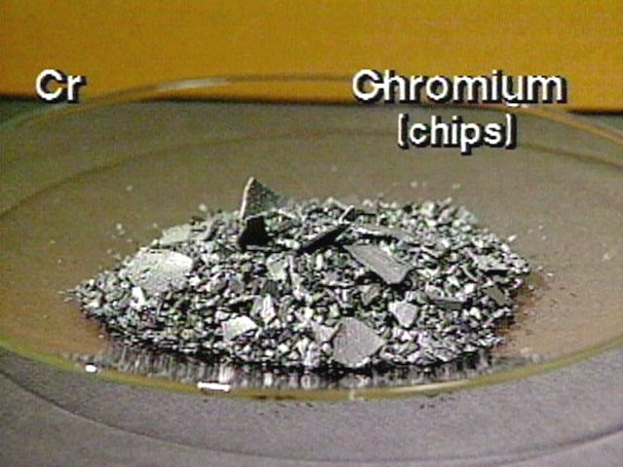
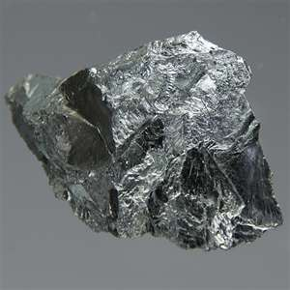
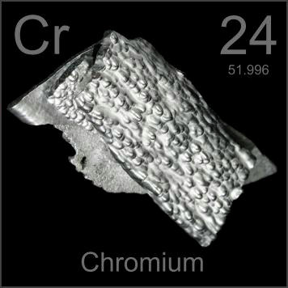
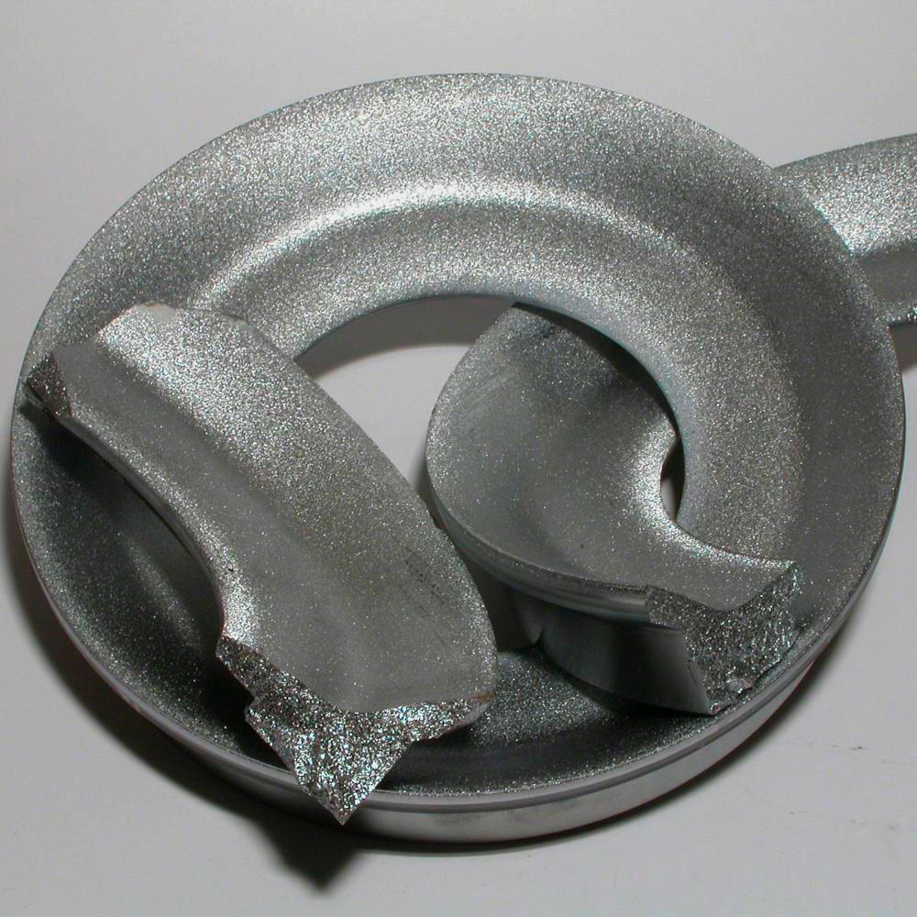
Chromium
solid chromium

Slide 8

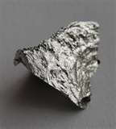
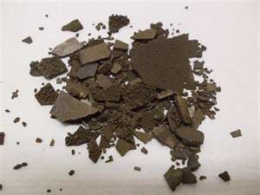
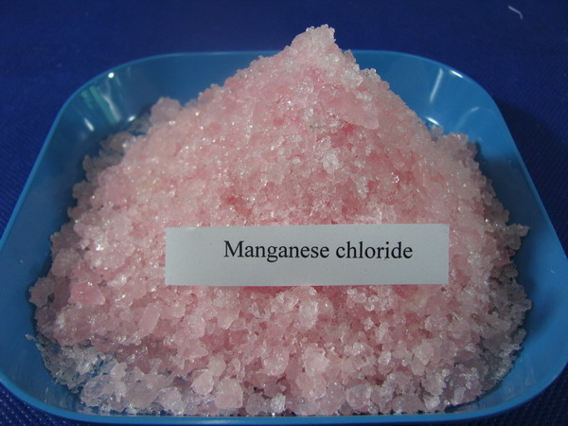
Manganese metal
Manganese ore
Manganese chloride-4-water

Slide 9
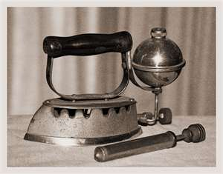
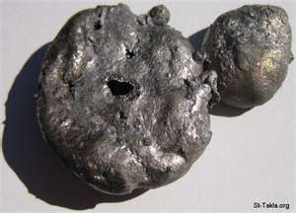
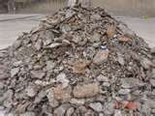
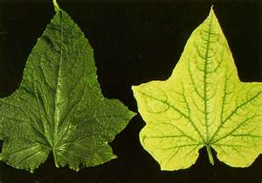
An iron ore
Antique Kerosene Iron
Iron-deficient plants
Pig iron scrap

Slide 10
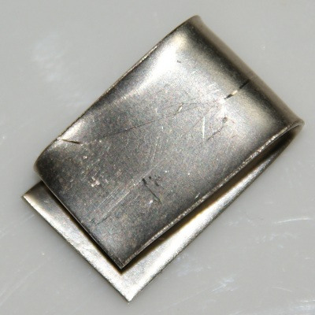

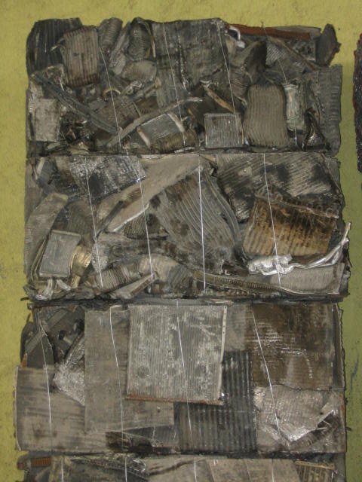


Nickel sheet
2007 Toyota Camry Hybrid nickel-metal hydride battery
nickel alloys
Ferrous scrap
Nickel Chair
Nickel Finishes

Slide 11
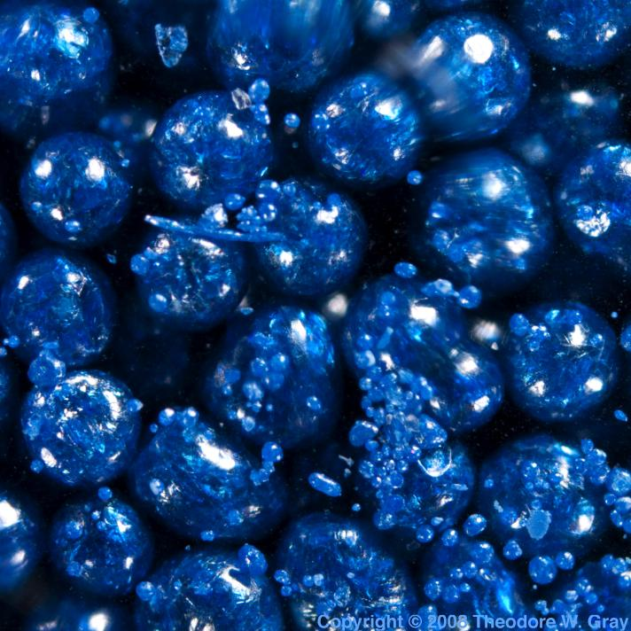
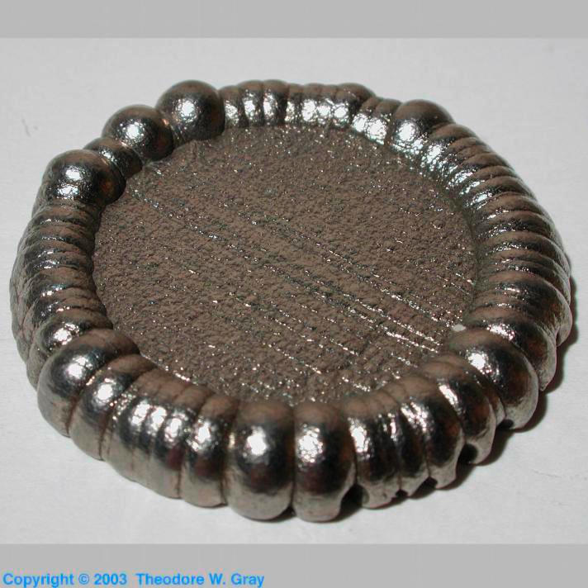
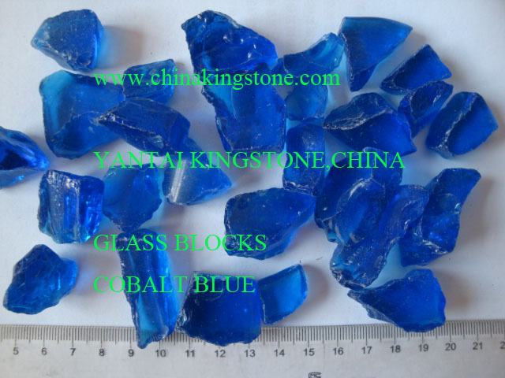
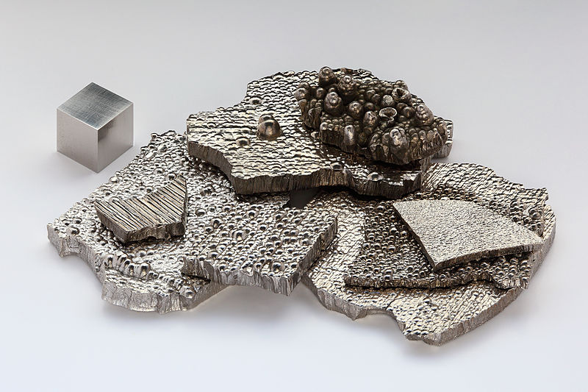
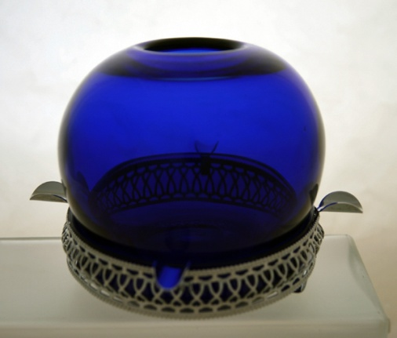
Cobalt blue
Cobalt (II) chloride
Cobalt (II) chloride
Cobalt Blue Ball Vase & Matching
Ashtray
Metallic cobalt

Slide 12
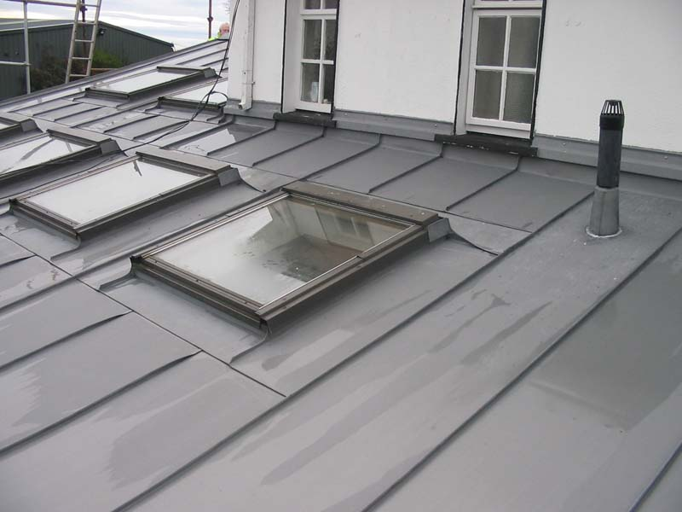
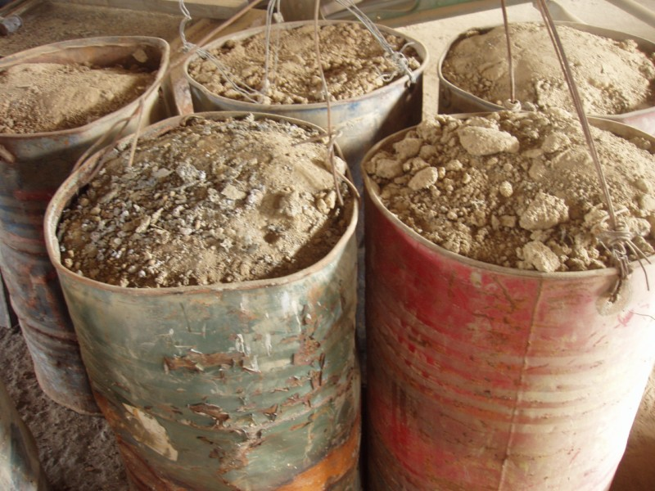


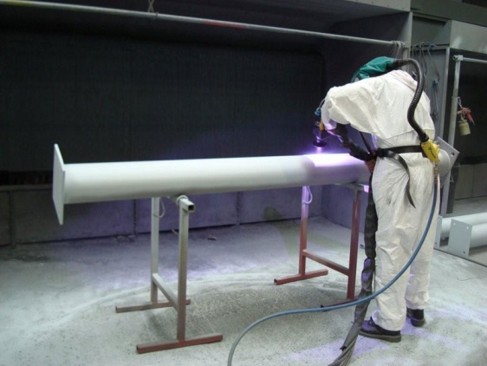
zinc has been used for roofing and various weatherproofing constructions
Zinc scrap
Zinc Metal Spraying
Metal Zinc
Metal Finishing - Zinc Electroplating

Slide 13
The electronic structures of the d block elements shown are:
Sc: [Ar] 3d¹4s²
Ti : [Ar] 3d²4s²
V: [Ar] 3d³4s²
Cr:[Ar] 3d⁵4s¹
Mn:[Ar] 3d⁵4s²
Fe:[Ar] 3d⁶4s²
Co:[Ar] 3d⁷4s²
Ni:[Ar] 3d⁸4s²
Cu:[Ar] 3d¹⁰4s¹
Zn:[Ar] 3d¹⁰4s²

Slide 14
scandium and zinc don't count as transition metals.
Reason:
E.C of Scandium atom: [Ar] 3d¹4s².
Sc³⁺ ion : [Ar] 3d⁰4s⁰
The Sc³⁺ ion has no d electrons
E.C of zinc atom : [Ar] 3d¹⁰4s².
Zn²⁺ ion :[Ar] 3d¹⁰.
The zinc ion has full d levels

Slide 15
Transition metal ion:
When d-block elements form ions, the 4s electrons are lost first.
Example 1:
Co : [Ar] 3d⁷4s²
Co²⁺ : [Ar] 3d⁷
Example 2:
V : [Ar] 3d³4s²
V³⁺ : [Ar] 3d²
The 4s electrons are lost first followed by one of the 3d electrons.

Slide 16
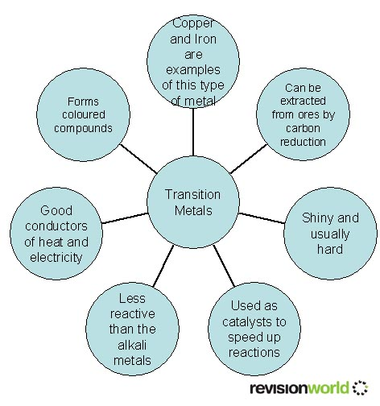

Slide 17
Characteristics properties of transition metals
1. Variable oxidation states in compounds
Most transition metals form more than one oxidation state in their compounds.
Example : Manganese
Manganese has a very wide range of oxidation states in its compounds.
+2 in Mn²⁺
+3 in Mn₂O₃
+4 in MnO₂
+6 in MnO₄²⁻
+7 in MnO₄⁻

Slide 18
Common oxidation state across the period
Beginning of period: +3 increased to +7
For Fe & Co : +3 & +2
End of period: +2
Sc | Ti | V | Cr | Mn | Fe | Co | Ni | Cu | Zn
+3 | +3 +4 | +3 +5 | +3 +6 | +2 +4 +7 | +2 +3 | +2 +3 | +2 | +2 | +2

Slide 19
Explaining the variable oxidation states in the transition metals
Reason:
Small energy difference between the 4s and 3d sub-shells. So no big jump in ionisation energy on removing electron from 4s and 3d sub-shells.

Slide 20
First six ionisation energies(in kJ mol⁻¹) for iron and Mn compared with those of calcium are:
metal | 1st IE | 2nd IE | 3rd IE | 4th IE | 5th IE | 6th IE
Ca | 590 | 1150 | 4940 | - | -
Fe | 762 | 1560 | 2960 | 5400 | 7620 | 10100
Mn | 716 | 1510 | 3250 | 5190 | 7360 | 9750

Slide 21
2. Readily form complex ions
Most aqueous solution of d block compounds contain complexes ion.
What is a complex ion?
A complex ion has a metal ion at its centre with a number of other molecules or ions surrounding it.
These species are called ligands.
The ligands attached to the central ion by dative covalent bonds.

Slide 22
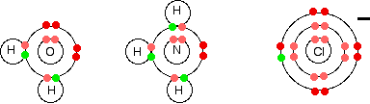
ligands like water, ammonia and chloride ions have at least one lone pair of electron that can donate to the metal ion.

Slide 23
Examples of complex ions:
Fe²⁺ ions in aqueous solution form the complexes
ion, [Fe(H₂O)₆]²⁺
Complexes that contain
(i) neutral ligands are positively charged.
eg. [Co(NH₃)₆]²⁺
(ii) anions as ligands may be electrically
neutral or have an overall negative charge.
Eg. [ Fe(OH)₃(H₂O)₃], [Cr(OH)₆]³⁻&[CuCl₄]²⁻

Slide 24
Note:
Other metals also form complex ions however
transition metals form a very wide range of
complex ions.
Eg. [Al(H₂O)₆]³⁺
Electrically charged complexes attract polar
molecules strongly and therefore water soluble,
whereas neutral complexes are insoluble and
readily precipitate from solution.
When writing formulae, a complex is enclosed
within square brackets

Slide 25
Using orbital diagram to show the formation of complex ion and shape of complexes.
Example 1 : [Fe(H₂O)₆]³⁺
Iron has the electronic structure 1s²2s²2p⁶3s²3p⁶3d⁶4s²
forms an Fe³⁺ ion it loses the 4s electrons
and one of the 3d electrons to leave
1s²2s²2p⁶3s²3p⁶3d⁵

Slide 26
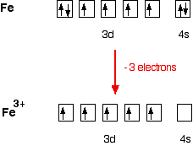

Slide 27
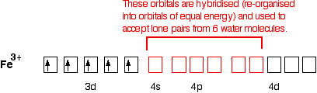
the ion uses 6 orbitals from the 4s, 4p and 4d levels to accept lone pairs from the water molecules.

Slide 28
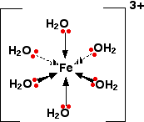
Because the iron is forming 6 bonds, the co-ordination number of the iron is 6.

Slide 29
Example 2 : Formation of CuCl₄ ²⁻
EC of Copper atom :1s²2s²2p⁶3s²3p⁶3d¹⁰4s¹
Cu²⁺ ion : 1s²2s²2p⁶3s²3p⁶3d⁹4s⁰4p⁰
the empty 4s and 4p orbitals are used to accept a lone
pair of electrons from each chloride ion.
Because chloride ions are bigger than water molecules,
you can't fit 6 of them around the central ion - that's why
you only use 4.

Slide 30
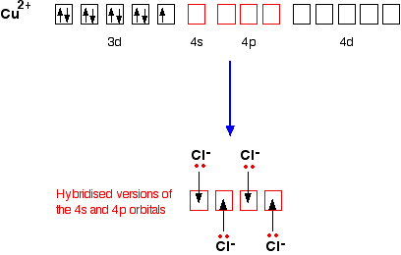

Slide 31
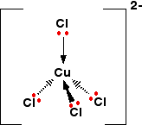
That gives you the complex ion:

Slide 32
why transition metals form stable complex ions :
Their ions are small and have a high charge density.
They have 3d orbitals of low energy level that can accommodate electrons donated by the ligands.

Slide 33
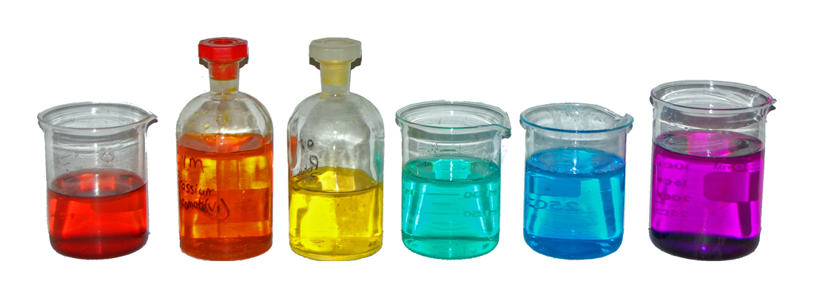
3. Their compounds are colored

Slide 34
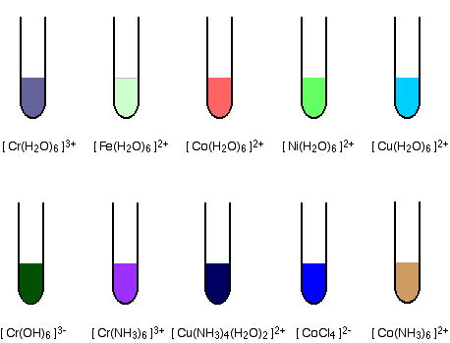
The diagrams show approximate colors for some common transition metal complex ions.

Slide 36

Why do we see some compounds as
being colored?
White light
The diagram shows an approximation to the spectrum
of visible light.

Slide 37
Why is copper(II) sulphate solution blue?
If white light passes through copper(II) sulphate solution,
some wavelengths in the light are absorbed by the
solution.
Copper(II) ions in solution absorb light in the red region
of the spectrum.
The light which passes through the solution will have all
the colors in it except for the red.
We see this mixture of wavelengths as pale blue (cyan).

Slide 38
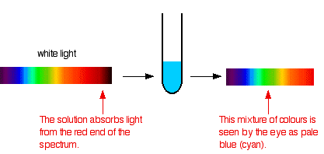
The diagram below show what happens if you pass white light through copper(II) sulphate solution.

Slide 39
Mixing different wavelengths of light doesn't give
you the same result as mixing paints or other pigments.
You can get some estimate of the color you
would see using the idea of complementary colors.
Complementary colors
If you arrange some colors in a circle, you get
a "color wheel".
The diagram shows one possible version of this.

Slide 40
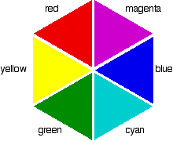

Slide 41
Colors directly opposite each other on the color wheel are said to be complementary colors.
Mixing together two complementary colors of light will give you white light.
What this all means is that if a particular color is absorbed from white light, what your eye detects by mixing up all the other wavelengths of light is its complementary color.
Copper(II) sulphate solution is pale blue (cyan) because it absorbs light in the red region of the spectrum. Cyan is the complementary color of red.

Slide 42
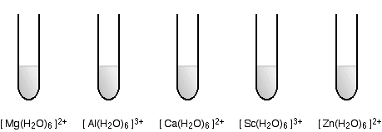
Some sample colors
The diagrams show the approximate colors of some
typical metal ions, with the formula [ M(H₂O)₆ ] ^{n+}.
The charge on these ions is typically 2+ or 3+.
They are non-transition metal ions
These ions are all colorless.

Slide 43
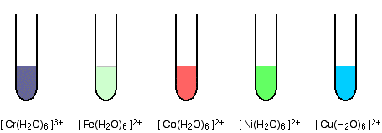
what causes transition metal ions to absorb wavelengths from visible light (causing colour) whereas non-transition metal ions don't? And why does the colour vary so much from ion to ion?
Transition metal ions
The transition metal ions are colored.

Slide 44
What causes transition metal ions to absorb
wavelengths from visible light ?
Why non-transition metal ions are colorless?
Why does the color vary so much from ion to ion?

Slide 45
The origin of color in complex ions containing transition metals
Complex ions containing transition metals are usually colored, whereas the similar ions from non-transition metals aren't. That suggests that the partly filled d orbitals must be involved in generating the color in some way.

Slide 46
we are going to look at the octahedral complexes which have six simple ligands arranged around the central metal ion.
When the ligands bond with the transition metal ion, there is repulsion between the electrons in the ligands and the electrons in the d orbitals of the metal ion. That raises the energy of the d orbitals.
because of the way the d orbitals are arranged in space, it doesn't raise all their energies by the same amount.
It splits them into two groups.

Slide 47
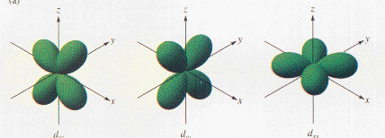

Slide 48
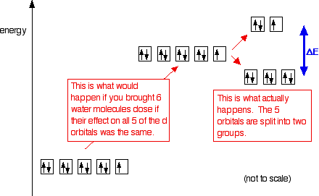
The diagram shows the arrangement of the d electrons
in a Cu²⁺ ion before and after six water molecules
bond with it.

Slide 49
When 6 ligands are arranged around a transition metal
ion
the d orbitals are split into 2 groups : 2 with a higher
energy than the other 3.
The size of the energy gap between them
(shown by the blue arrows on the diagram) varies with the
nature of the transition metal ion,
its oxidation state of metal ion ,
the nature of the ligands.

Slide 50

When white light is passed through a solution ,
some of the energy in the light is used to promote an
electron from the lower set of orbitals into a space in
the upper set.

Slide 51
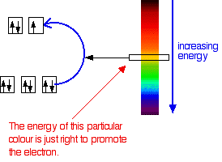
Suppose that the energy gap in the d orbitals of the
complex ion corresponded to the energy of yellow light.

Slide 52
The yellow light would be absorbed because its energy
would be used in promoting the electron.
That leaves the other colors.
Your eye would see the light passing through as a dark blue,
because blue is the complementary color of yellow.

Slide 53
What about non-transition metal complex ions?
Non-transition metals don't have partly filled d orbitals.
Non-transition metals don't have any electron transitions which can absorb wavelengths from visible light.
Example 1:
scandium ion (Sc³⁺) hasn't got any d electrons left to move around.
Scandium(III) complexes are colorless because no visible light is absorbed.

Slide 54
Example 2:
In the zinc,
the 3d level is completely full
there aren't any gaps to promote an electron
Zinc complexes are also colorless.

Slide 55
The factors affecting the color of a transition metal complex ion
1. The nature of the ligand
Different ligands have different effects on the energies of the d orbitals of the central ion. Some ligands have strong electrical fields which cause a large energy gap when the d orbitals split into two groups.
Others have much weaker fields producing much smaller gaps.
Remember that the size of the gap determines what wavelength of light is going to get absorbed

Slide 56
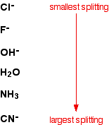
The list shows some common ligands.

Slide 57
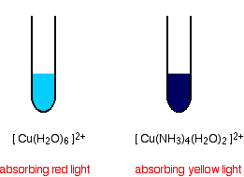
Example:
If you add an excess of ammonia solution to
copper(II) ions in solution,
the pale blue (cyan) colour is replaced by a
dark inky blue as some of the water molecules in the
complex ion are replaced by ammonia.

Slide 58
The first complex must be absorbing red light in order to give
the complementary color cyan.
The second one must be absorbing in the yellow region
in order to give the complementary color dark blue.
Yellow light has a higher energy than red light. You need that
higher energy because ammonia causes more splitting of
the d orbitals than water does.

Slide 59
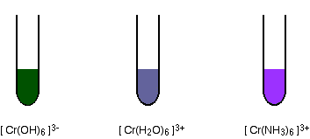
The diagrams show some approximate colors of
some ions based on chromium(III).
It is obvious that changing the ligand is changing the color, but trying to explain the colors in terms of our simple theory isn't easy.

Slide 60
2. The oxidation state of the metal
As the oxidation state of the metal
increases, so does the amount of splitting
of the d orbitals.
Changes of oxidation state change the
color of the light absorbed, and so the
color of the light you see.

Slide 61

Example : chromium
A change of oxidation state from +2 to +3:

Slide 62

3. The nature of the ligands
Example 1

Slide 63

Example 2:
If you add concentrated hydrochloric acid to a solution
containing copper(II) ions, the six water
molecules are replaced by four chloride ions.

Slide 64

4. Has Catalytic activity

Slide 65
Transition metals and their compounds are
good catalysts.
because of their ability to change oxidation
state
Or
to adsorb other substances on to their surface and activate them in the process.

Slide 66
Some process using transition metal as
catalyst are as follow:
Example 1 : The Haber Process
hydrogen and nitrogen combines to make ammonia
using an iron catalyst.

Slide 67
Example 2: Reaction between persulphate ions
and iodide ions
The reaction is catalysed using either iron(II) or iron(III) ions.
The reaction happens in two stages.
If you use iron(III) ions, the second of these
reactions happens first.
Iron act as catalysts because of its ability to
change oxidation state.

Slide 68
Example 3: Nickel in the hydrogenation
of C=C bonds
In industrial: manufacture of margarine from
vegetable oils.
In laboratory: ethene and hydrogen in the
presence of a nickel catalyst.

Slide 69

Example 4: Vanadium(V) oxide as a catalyst in the
Contact Process

Slide 70
Mechanism:
The sulphur dioxide is oxidised to sulphur trioxide
by the vanadium(V) oxide.
vanadium(V) oxide is reduced to vanadium(IV) oxide.
The vanadium(IV) oxide is then re-oxidised by the oxygen.
the catalyst has been temporarily changed during
the reaction, at the end it is chemically the same as
it started.

Slide 71

The end
Zinc Metal and Copper Sulfate Solution - some hours later, blue color has disappeared, copper metal has appeared, some clings to the zinc rod

Slide 72
Uses of scandium
One of the most important scandium uses is for preparing aluminum-scandium alloys which is used in aerospace industry for making aircraft. When it is added in trace amount (about 0.1% to 0.5%) to aluminum, it increases the strength of aluminum manifolds without increasing its weight. Its use in aerospace industry is restricted to specialized aircraft .
Another use of this aluminum-scandium alloy is in the manufacturing of various sports equipment like baseball bats, lacrosse sticks and bikes. All these items have a common requirement: a high performance material which is light in weight, rust resistant and have high melting point.
Commercially, scandium is used in large scale for making metal halide lamps. These lamps are partially modified mercury vapor lamp in which a combination of scandium iodide and sodium iodide is added to get an effect of high intensity white light. The artificial light thus produced is quite similar to that of natural sunlight. These lamps are in demand that it is estimated that almost 80 kg of scandium is used every year, all over the world for production of these lamps.

Slide 73
Chromium
Uses: Chromium is used to protect surfaces from corrosion. It makes and keeps objects like vehicles, kitchen utensils and electric parts shiny. Chromium is also the element that makes stainless steel "stainless". It does so by coating the steel with a thin shiny layer of chromium that keeps rust out. Chromium is also used for making paints and dyes.
Health: Small amounts of chromium III, are good for the body. Chromium III is found in black pepper, broccoli, fruit juices and some meats like turkey.
It is said to help dieting, reduce cholesterol and change blood sugar into energy for the body. Scientists think that chromium helps the body respond properly to insulin. Most people need 28 nanograms of chromium a day.
Another variety of chromium, Chromium VI, is toxic.
It can cause asthma, nosebleeds and nasty rashes on the body.

Slide 74
Titanium:
Titanium is a strong lightweight metal often used in airplanes. When titanium combines with oxygen, it forms titanium dioxide (TiO2), a brilliant white pigment used in paint, paper, and plastics.

Slide 75
Nickel
Nickel is extremely rare in nature, as it is almost always alloyed with iron. Iron meteorites, for example, are typically 6% to 20% nickel.
Nickel is a quite inert metal, which often is used for plating, but frequently causes allergic reactions on the skins of many people. Nickel is ferromagnetic and, together with iron, forms the inner core of the Earth, which is a big magnet.

