Slide 1
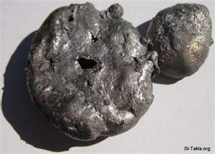
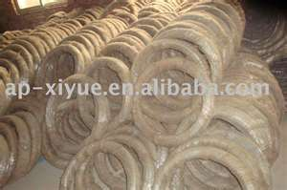
Iron
Lumps of Iron metal
produced by an Iron(III)
Oxide thermite reaction
Iron Metal wire

Slide 2
Iron and its compounds
Physical properties of iron
Reaction of iron
Reaction of iron (II) compounds
Reaction of iron(III) compounds

Slide 3
I. Physical properties of iron
Pure iron is a soft metal, with a silver white or grayish color.
Iron has the properties of ductility, malleability and thermal conductivity.
Malleability lets Iron be beaten into sheets, without cleavage and ductility makes it possible for thin wires to be drawn from it.

Slide 4
Iron's has four unpaired electron and
peculiar crystalline structure makes it to
be naturally attractive to magnets. In
other words, it is known to be a
ferromagnetic material.
Fe:[Ar] 3d⁶4s²
The crystal structure and magnetism of
iron undergo changes when it is heated.
If an iron magnet is heated red hot, it loses its magnetism but regains it when it is cooled.

Slide 5
There are four isotopes of Iron :⁵⁴Fe, ⁵⁶Fe, ⁵⁷Fe and ⁵⁸Fe.
⁵⁶Fe is the most abundant, with an abundance of 91.754% on Earth and it is the most stable nucleus.
The density of Iron, in solid phase is known to be
7.874 gm/cm³.
Iron has a melting point of 1538 ºC and a boiling
point of 2862 ºC .
Iron is mostly used in the form of alloys and as the prime constituent element of steel alloys.

Slide 6
II. Reaction of iron
Reaction of iron with air and water
In the presence of moisture, iron rusts quickly because it combines easily with oxygen in the air to form red hydrated Fe₂O₃.
rusting is an exothermic process.
Iron can be protected against rusting by coating it with a phosphate solution.
Coating iron with zinc to make galvanized iron also prevents rusting.

Slide 7
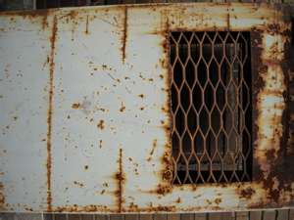
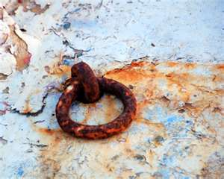

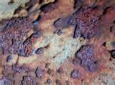
Rust-flake

Slide 8
The color of dried Fe₂O₃ is intense, and it is used as a red pigment in pints, rubber, ceramics, and glass.
Burning the dry steel wool in air results in
magnetite, FeO·Fe₂O₃, a black compound
that is weakly magnetic.
Equation of reaction:
4Fe(s) + 3O₂(g) → 2Fe₂O₃(s)
3Fe(s) + 2O₂(g) → Fe₃O₄(s)

Slide 9
b. Reaction of iron with halogen
Iron reacts with excess of the halogens F₂, Cl₂,
and Br₂, to form iron(III) halides.
2Fe(s) + 3F₂(g) → 2FeF₃(s) (white)
2Fe(s) + 3Cl₂(g) → 2FeCl₃(s) (dark brown)
2Fe(s) + 3Br₂(l) → 2FeBr₃(s) (reddish brown)
The direct reaction between iron metal and
iodine can be used to prepare iron (II) iodide,
FeI₂.
Fe(s) + I₂(s) → FeI₂(s) (grey)
The iron(III) is too oxidizing and the iodide is too
reducing.

Slide 10
c. Reaction of iron with sulphur
Heating iron filings with powdered sulfur results in a
strongly exothermic reaction that produces a charcoal-grey
substance.
The substance is commonly identified as iron(II) sulfide,
FeS, it has a complex structure, FeS₂ (pyrite)
It is not iron(IV) sulfide; the iron is in a +2 oxidation state,
combined with an S₂²⁻ ion
Pyrite burns when heated to form sulfur dioxide and
iron(III) oxide:
4 FeS₂(s) + 11 O₂ →2 Fe₂O₃(s) + 8 SO₂(g)
The reaction is used in industry as a source of sulfur dioxide
for the manufacture of sulfuric acid.

Slide 11
Movies for the reaction of iron with sulphur
1.
http://www.youtube.com/watch?v=A5H6DVe5FAI&feature=related
2.
http://www.youtube.com/watch?v=uAxhvJQ2oS4&feature=related
3.
http://www.youtube.com/watch?v=hWpmSRbEQRg&NR=1

Slide 12
c. Reaction of iron with acid
Iron metal dissolves readily in dilute sulphuric acid
in the absence of oxygen to form Fe(II) ion and
hydrogen gas, H₂.
In practice, the Fe(II) is present as the complex ion
[Fe(OH₂)₆]²⁺.
Fe(s) + H₂SO₄(aq) → Fe²⁺(aq) + SO₄²⁻(aq) + H₂(g)
If oxygen is present, some of the Fe(II) oxidizes to
Fe(III).
concentrated nitric acid, HNO₃, reacts on the
surface of iron and passivates the surface.

Slide 13
II. Reaction of iron (II) compounds
Reaction of iron (III) oxide with aluminium powder
(Thermite reaction)
Equation of reaction is Fe₂O₃ + 2Al --> Al₂O₃ + 2Fe
The mixture burns at a very high temperature around
2000 °C to about 3000°C.
Materials Needed :
Iron(III) oxide, Fe₂O₃ :50 g
Aluminum powder, Al : 15g
Magnesium ribbon, Mg : 2.5 cm long
Potassium permanganate, KMnO₄ : a small scoop
Glycerin, C₃H₅(OH)₃ :2-3 drops :

Slide 14
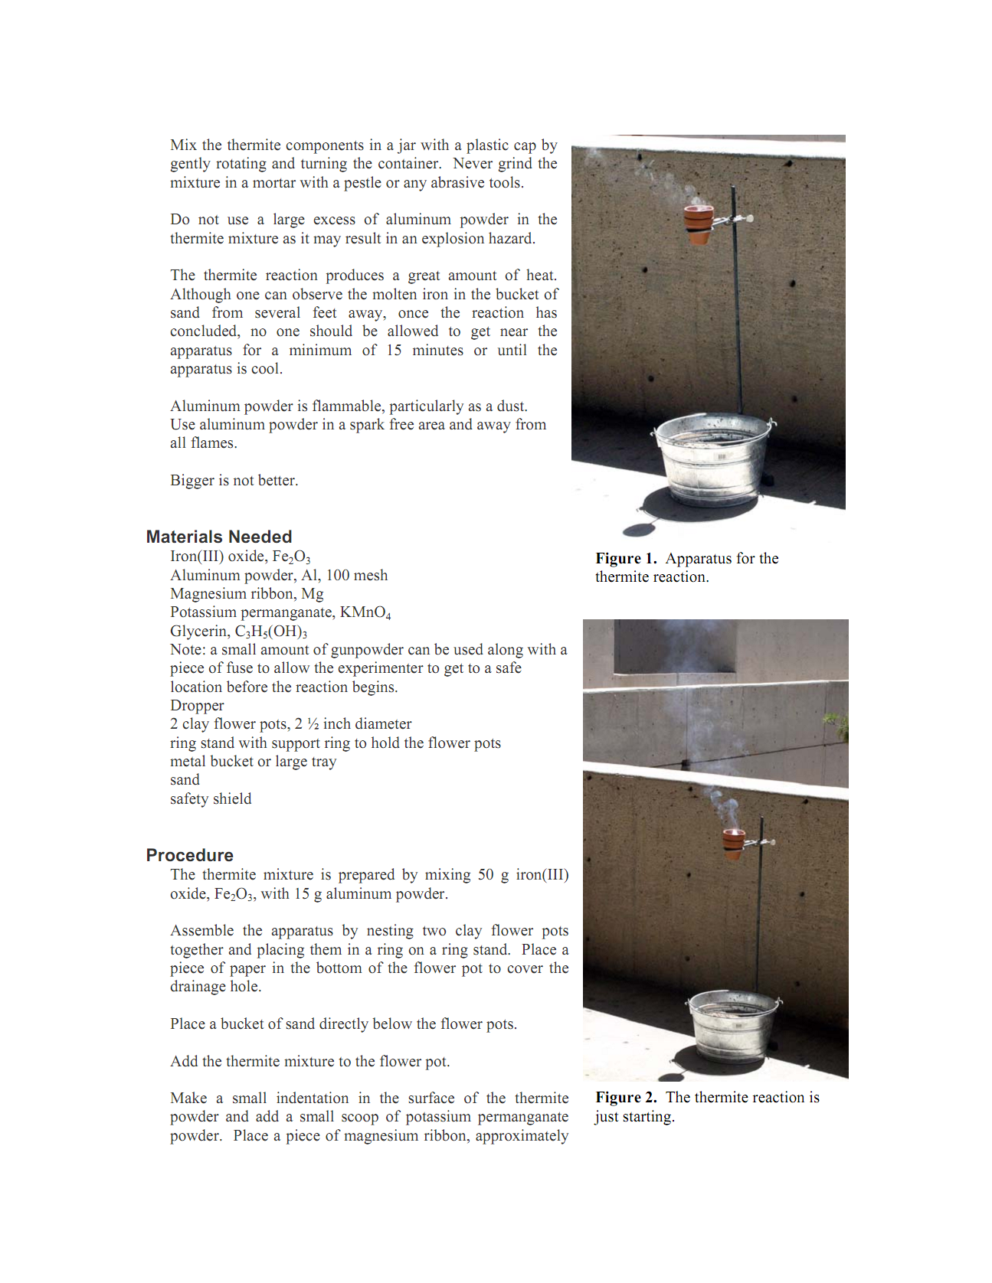

Slide 15
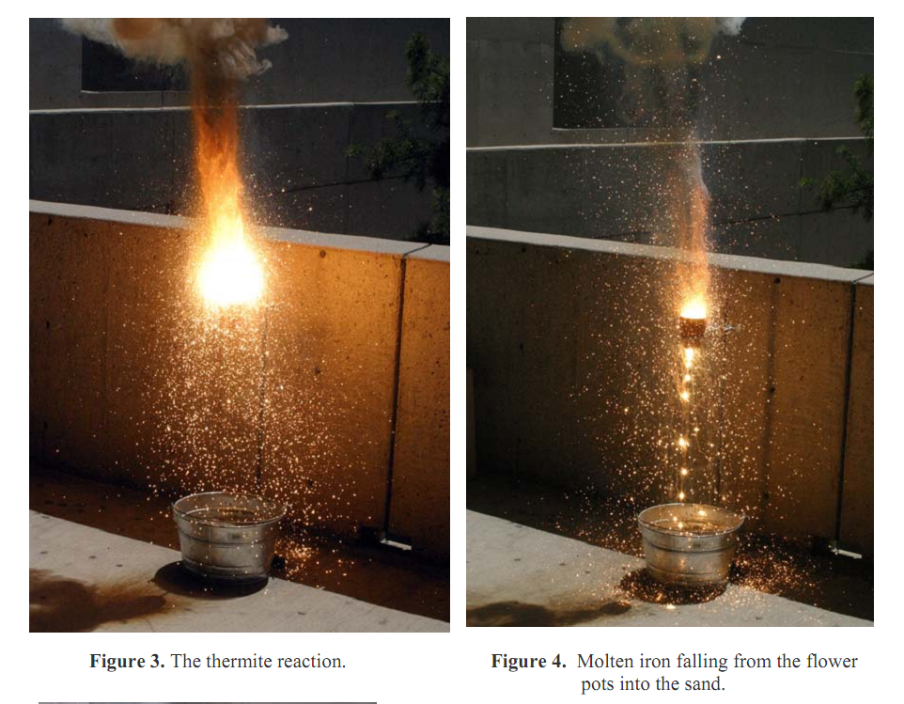

Slide 16
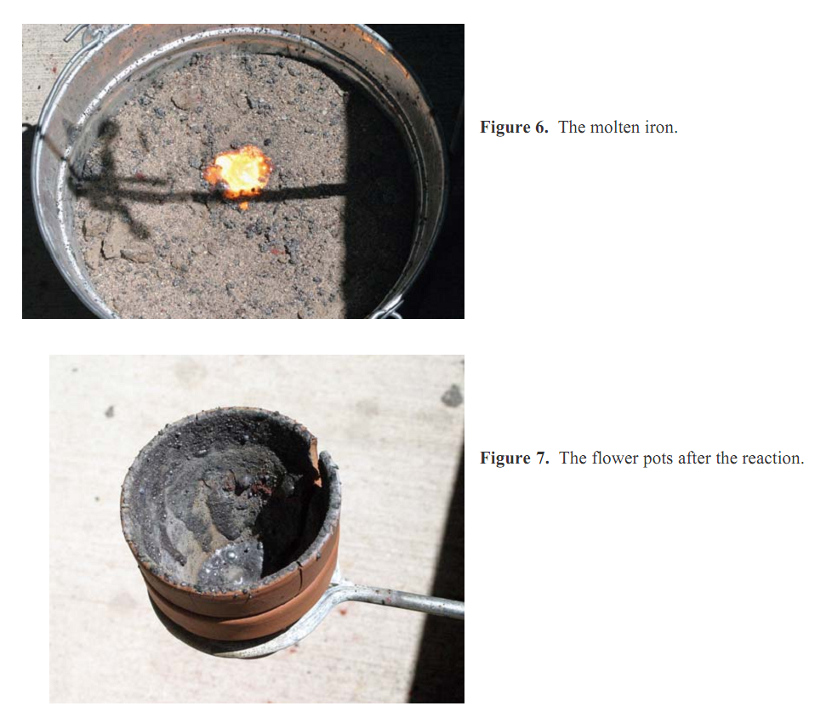

Slide 17
Movies : Thermite reaction
1. http://www.youtube.com/watch?v=GyVD8V0016w
2. http://www.youtube.com/watch?v=AQwOdjTRbxk&playnext=1&list=PL00DB196EE725418A
3. thermite weld : http://www.youtube.com/watch?v=nR6K90cR8Lg&feature=related

Slide 18
III. Reaction of iron (II) & iron(III) compounds
The simplest iron (II) & iron (III) ions in solution are:
[Fe(H₂O)₆]²⁺and [Fe(H₂O)₆]³⁺.
They are both acidic, but the iron(III) ion is
more strongly acidic.
a. Reactions of the iron (II) & iron (III) ions with sodium hydroxide ions

Slide 19
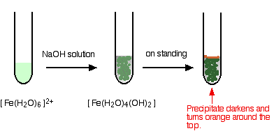

Slide 20
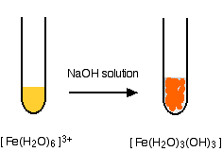

Slide 21
b. Reactions of the iron (II) & iron (III) ions
with ammonia solution
Ammonia act as a base removing hydrogen
ions from the aqua complex.
Result : same as when you add sodium hydroxide solution.
i.e : Fe³⁺(aq) + 3OH⁻(aq) → Fe(OH)₃(s)

Slide 22
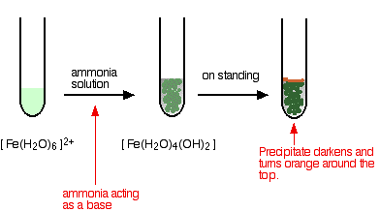
iron(II) and ammonia solution:

Slide 23
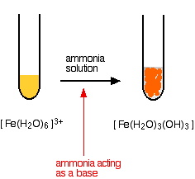
iron(III) and ammonia solution:

Slide 24
Aqueous ammonia is a weak base, it is slightly dissociate to ions as shown in equation below:
NH₄OH(aq) ↔ NH₄⁺ (aq)+ OH⁻ (aq)
Fe²⁺ (aq) + 2OH⁻ (aq)→ Fe(OH)₂(s)
light green solution dirty green ppt
Fe³⁺ (aq) + 3OH⁻ (aq)→ Fe(OH)₃(s)
brown solution reddish brown ppt

Slide 25
Oxygen in the air oxidises the iron(II) hydroxide precipitate to iron(III) hydroxide especially around the top of the tube.
4 Fe(OH)₂(s) + O₂(g) + 2 H₂O(l) → 4 Fe(OH)₃(s)

Slide 26
c. Identify iron (II) and iron(III) ions
(i) with thiocyanate ions, SCN⁻
When iron(III) ions are added to a solution
containing thiocyanate ions, a blood red
complexes is formed [FeSCN] ²⁺ .
iron(II) does not cause a color change.

Slide 27
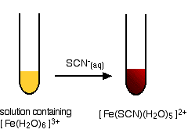

Slide 28
(ii) With potassium hexacyanoferrate(II) , K₄Fe(CN)₆
and potassium hexacyanoferrate(III),K₃Fe(CN) ₆
Both iron(II) and iron(III) ions form very stable complexes.
K₄ Fe(CN) ₆ + Fe³⁺ → KFe(II)Fe(III)(CN) ₆]
Yellow solution deep blue ppt
K₃Fe(CN) ₆ (aq) ⁺ Fe²⁺ (aq) → KFe(II)Fe(III)(CN) ₆
Deep red solution deep blue ppt
So, iron is used to complex waste cyanides to render
them less toxic.
The [Fe(CN)₆]⁴⁺ and [Fe(CN)₆]³⁺ ions contain covalent
iron-carbon bonds arranged octahedrally around the
central iron.

Slide 29
Using hydrogen sulphide gas
Fe²⁺ (aq) + H₂S(g) → 2H⁺(aq) + FeS(s)
black ppt
2Fe³⁺ (aq) + H₂S(g) → 2H⁺(aq) + Fe²⁺ (aq) + S(s)
yellow ppt

