Slide 1
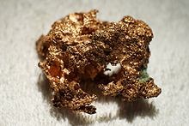
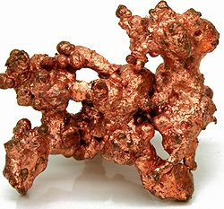
copper
Crystal of native copper
Native copper

Slide 2
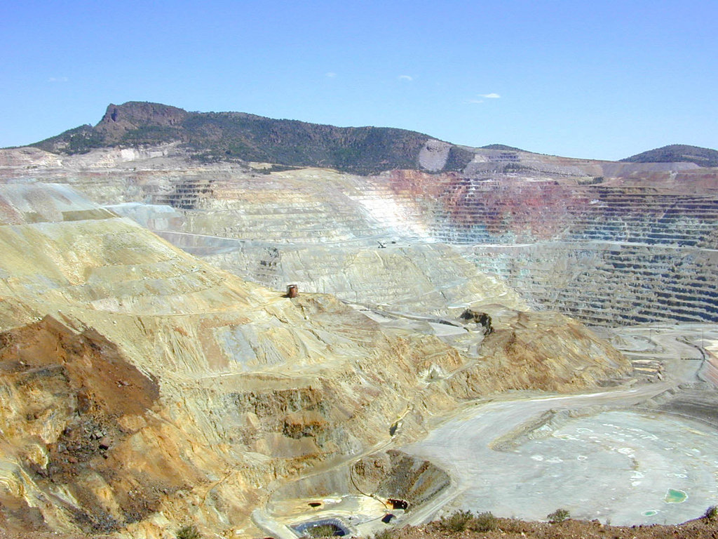
Copper mine

Slide 3
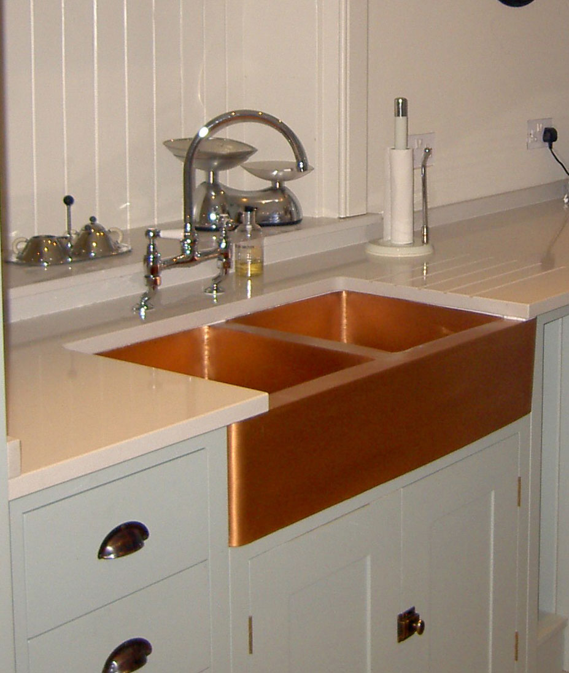
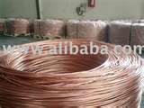
Copper Rod
Copper Kitchen Sinks

Slide 4
Physical properties of copper
Reaction of copper
Copper (II) chemistry
IV. Copper (I) chemistry

Slide 5
I. Physical properties of copper
Copper is a reddish metal
atomic weight is 63.546 g/mol
is the twentieth most abundant element present in the Earth's crust
It is malleable, ductile.
good conductor of both heat and electricity.
It is softer than iron but harder than zinc and can be polished to a bright finish.
Density :8.94 g·cm⁻³
Melting point: 1084.62 °C
Boiling point: 2562 °C

Slide 6
Successive ionisation energies of copper
IE | IE1 | IE2 | IE3 | IE4 | IE5 | IE6 | IE7 | IE8 | IE9
kJ/mol | 745.5 | 1957.9 | 3555 | 5536 | 7700 | 13400 | 16000 | 19200 | 22400

Slide 7
II. Chemical reaction of COPPER
Electronic configuration of copper atom/ions
Cu : [Ar] 3d¹⁰4s¹
Cu⁺ : [Ar] 3d¹⁰4s⁰
Cu²⁺ : [Ar] 3d⁹4s⁰
It is found in Group 11 or 1B of the periodic table, together with silver and gold.
Copper has low chemical reactivity.
Copper does not react with water, but it slowly reacts with atmospheric oxygen forming a layer of brown-black copper oxide.
this coating protects the metal from further attack.
A green layer of copper carbonate [Cu(OH)₂.CuCO₃]can be seen on old copper constructions.

Slide 8
At high temperature, copper reacts with
Oxygen
2 Cu(s) + O₂(g) → CuO(s)
reddish metal black
CuO(s)+ Cu Cu₂O(s)
red solid
b. Sulphur
Cu(s) + S(g)→ CuS(s)
black
This is observed in everyday life when copper metal
surfaces tarnish after exposure to air containing sulfur
compounds.
c. Halogen
Cu(s) + Cl₂ (g)→ CuCl₂(s)

Slide 9
d. Copper reacts with hot concentrated sulphuric acid,
not affected by cold dilute sulphuric and
hydrochloric acids
Cu(s) + 2H₂SO₄ (aq,conc) → CuSO₄(aq) +SO₂(g) + 2 H₂O(l)
it dissolves in cold dilute nitric acid and hot
concentrated nitric acid.
Cu(s) + 4HNO₃ (aq,conc) →Cu(NO₃)₂(aq)+ 2NO₂(g) + 2 H₂O(l)
3Cu(s) + 8HNO₃ (aq,dilute) →Cu(NO₃)₂(aq)+ 2NO(g) + 4 H₂O(l)

Slide 10
III. Chemistry of copper(II)
The Cu(II) compounds are
a. paramagnetic because it has one unpaired electron.
Cu²⁺ : [Ar] 3d⁹4s⁰
b. colored.
Example: hydrated copper(II) ion is blue;
copper(II) oxide, CuO is black
copper(II) sulphate -5-water is blue;
copper(II) sulphide,CuS is black.

Slide 11
Chemical reactions of copper(II) ions
The simplest ion that copper forms in solution is the blue copper(II) ion - [Cu(H₂O)₆]²⁺.
Reaction of copper(II) ions with hydroxide ions
Hydroxide ions remove hydrogen ions from the water ligands attached to the copper ion.
a blue precipitate is formed.
Equation of reaction is:
Cu²⁺ (aq) + 2OH⁻(aq) → Cu(OH)₂(s)
Or

Slide 12
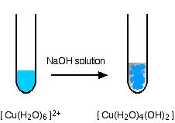

Slide 13
b .Reaction of copper(II) ions with ammonia
solution
The precipitate dissolves when excess of ammonia
solution is added.
Equations of reaction:

Slide 14
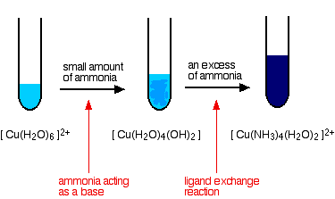

Slide 15
c. Reaction of copper(II) ions with hydrogen sulphide gas
Equation of reaction:
Cu²⁺ (aq) + H₂S (g) → CuS (s) + 2H⁺ (aq)
black ppt
Note: we can use 1. sodium hydroxide
2. ammonia solution
3. hydrogen sulphide
to test for the presence of Cu²⁺ ion.

Slide 16
IV. copper(I) chemistry
All compounds of Cu(I) are diamagnetic and colorless except for Cu₂O, which is red.
Cu⁺ : [Ar] 3d¹⁰4s⁰
Reducing sugars are detected by their ability to convert blue copper(II) complexes (Benedict’s reagent or Fehling’s solution) to reddish ppt of copper(I) oxide (Cu₂O).

Slide 17
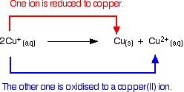
Cu(I) ions does not exist in aqueous solution
because aqueous copper(I) ions disproportionate to
give copper(II) ions and solid copper.

Slide 18
if copper(I) oxide react with hot dilute
sulphuric acid, a brown precipitate of copper
and a blue solution of copper(II) sulphate are formed.
Because copper (I) undergo self redox reaction.

Slide 19
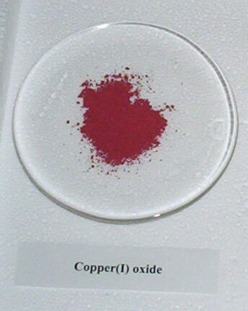

Slide 20
Copper(I) compounds which are stable in the presence of water must either be insoluble or complexes with ligands other than water.
Some insoluble copper (I) compounds are Cu₂O, CuCl and CuI.
some copper(I) complexes are [Cu(NH₃)₂]⁺ and [CuCl₂]⁻
Preparation of these complexes:

Slide 21
The end

Slide 22
Read more: http://www.answers.com/topic/copper-3#ixzz1G7ApMzoA

